Slide 1
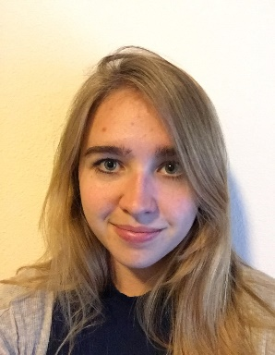
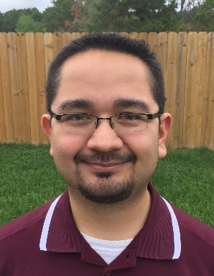
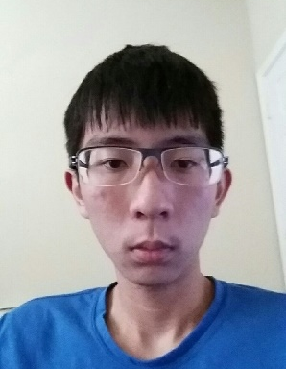

Project Avalanche
Team Booyah
Mario Aguilar Margaret Baxter
Patrick Quach Christine Russell

Slide 2
Introduction
Extend functionality of Project SkiLift
Create an Android GUI
Develop using Android Studio
Make use of SQLite and SPI
Practice using Agile development principles and practices (Scrum)
Practice presenting work to others in a public setting

Slide 3
Technical aspects
Project Avalanche will:
Run on an Android device
Run season simulations
Give predictions based on Power Ranking, Bayes, and Pi Rating prediction algorithms
Get predictions internally through the use of a Service Provider Interface
Uses SQLite as its DBMS
Seek to take advantage of distinct mobile device functionality

Slide 4
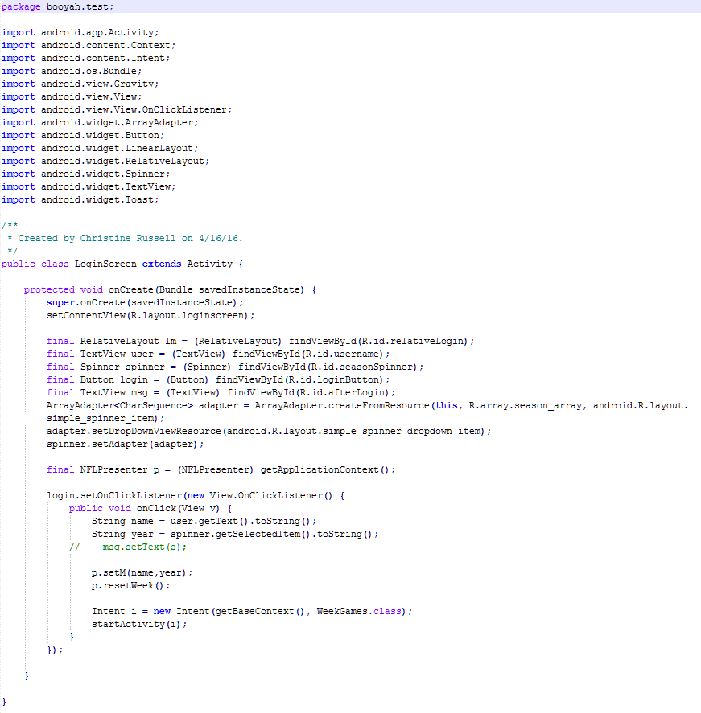
Code Snippet

Slide 5
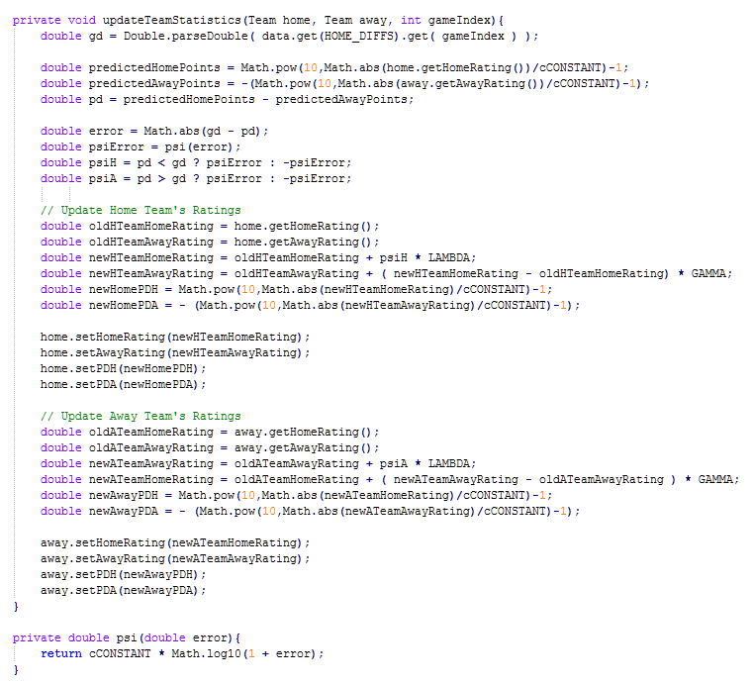
Code Snippet

Slide 6
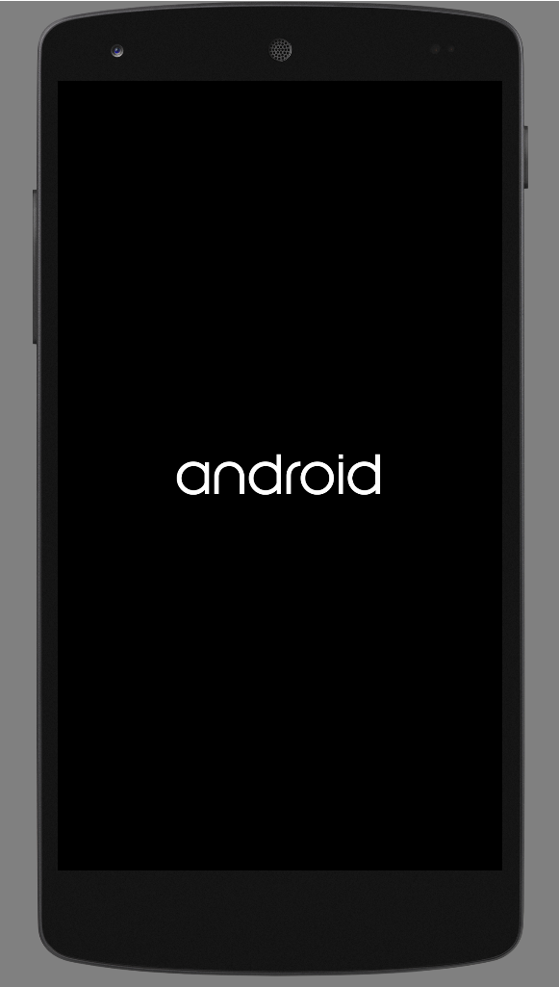
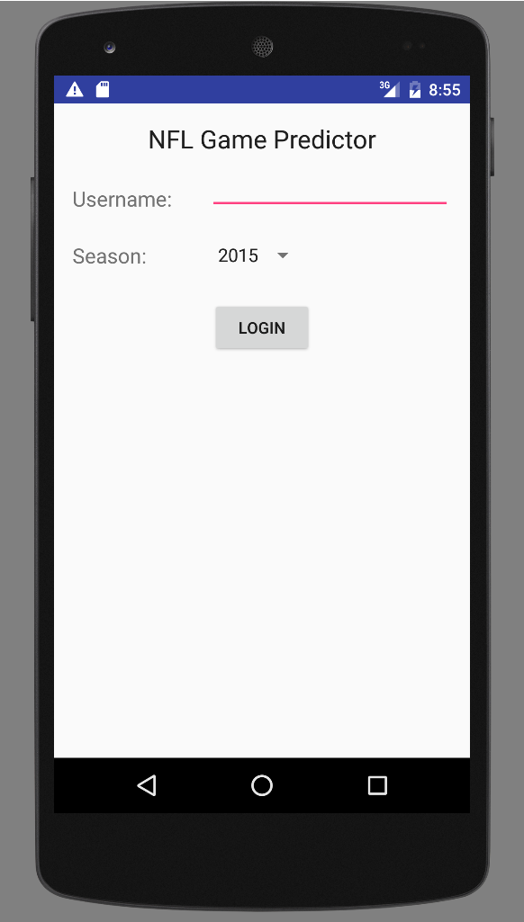
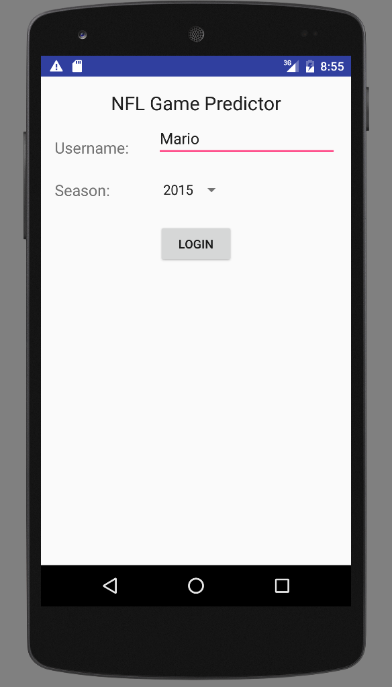
Screenshots

Slide 7
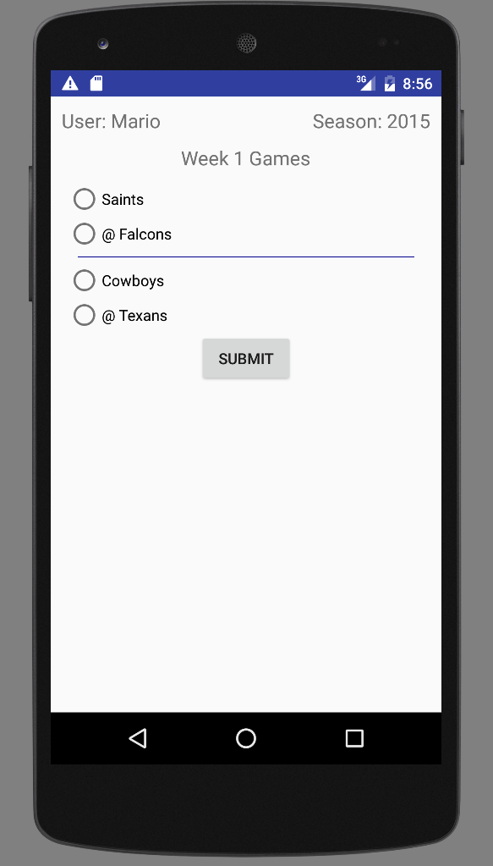
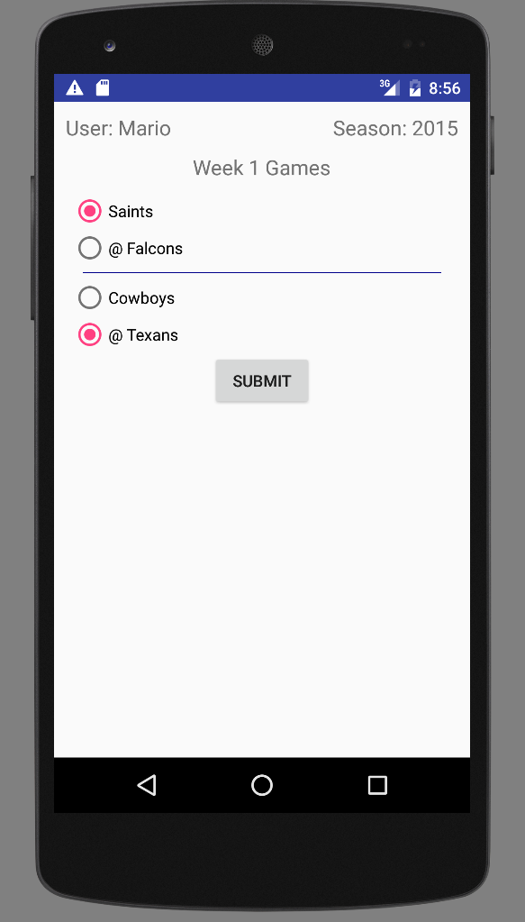
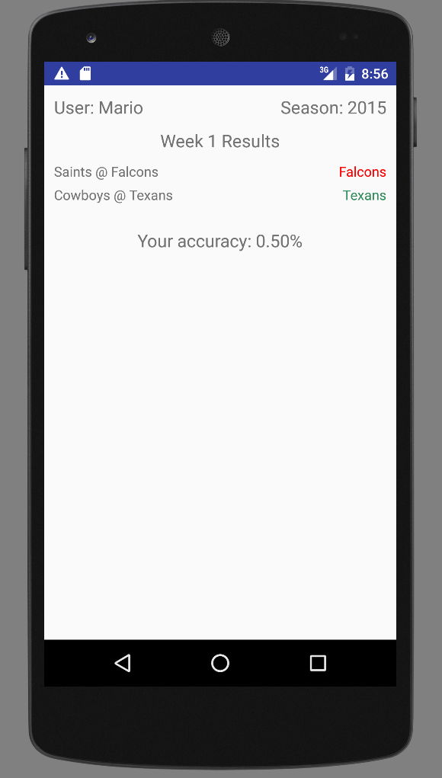
Screenshots

Slide 8
Conclusion
Created a base NFL App that will be expanded to include more features.
Pi Rating algorithm has been researched to determine confidence of predictions.
SPI Algorithms have been tweaked to give higher accuracies.
SQLite database will also be integrated into next week’s NFLApp release.

